Slide 1
1.Case Study of different types of Compiler

Slide 2
Types of Compiler
Native Compiler
Cross Compiler
Source to Source Compiler

Slide 3
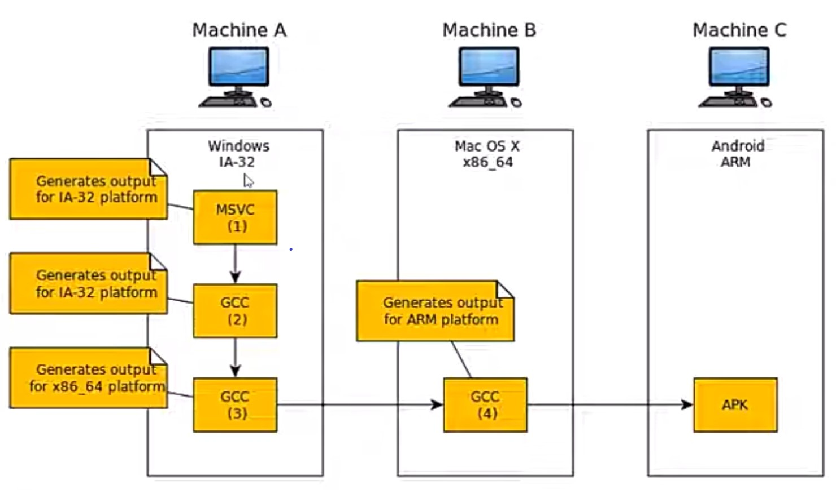

Slide 4
Native Compiler-
- The compilers used to compile a source code for same type of platform only.
Cross Compiler-
- The compilers used to compile a source code for different types of platforms.

Slide 5
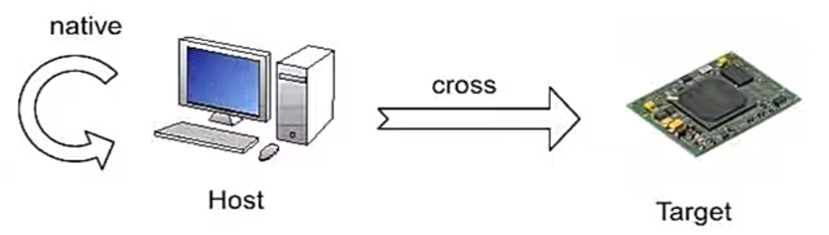
Native and Cross Compilers
A native compiler generates code for the same machine (host).
A cross compiler generates code for another machine (target)

Slide 6
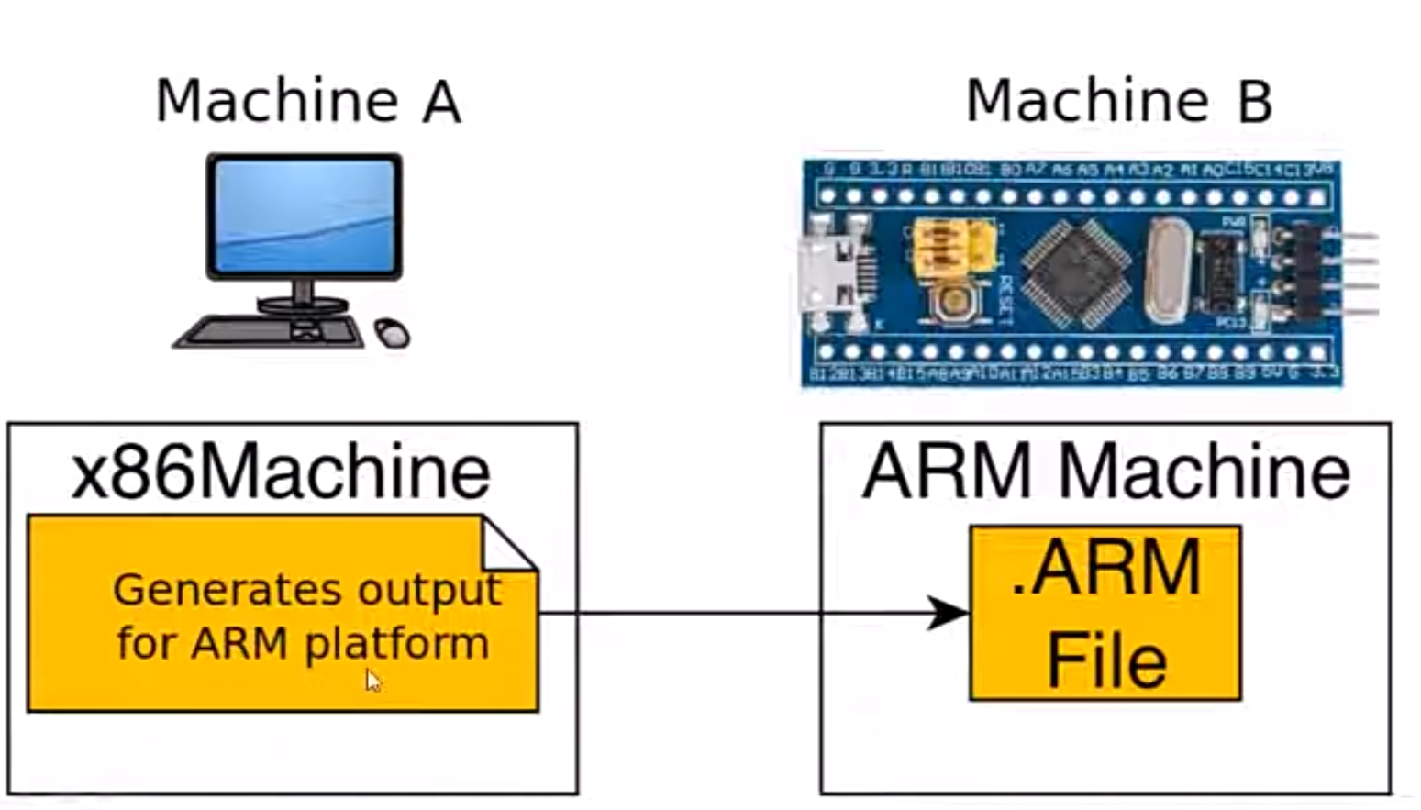

Slide 7
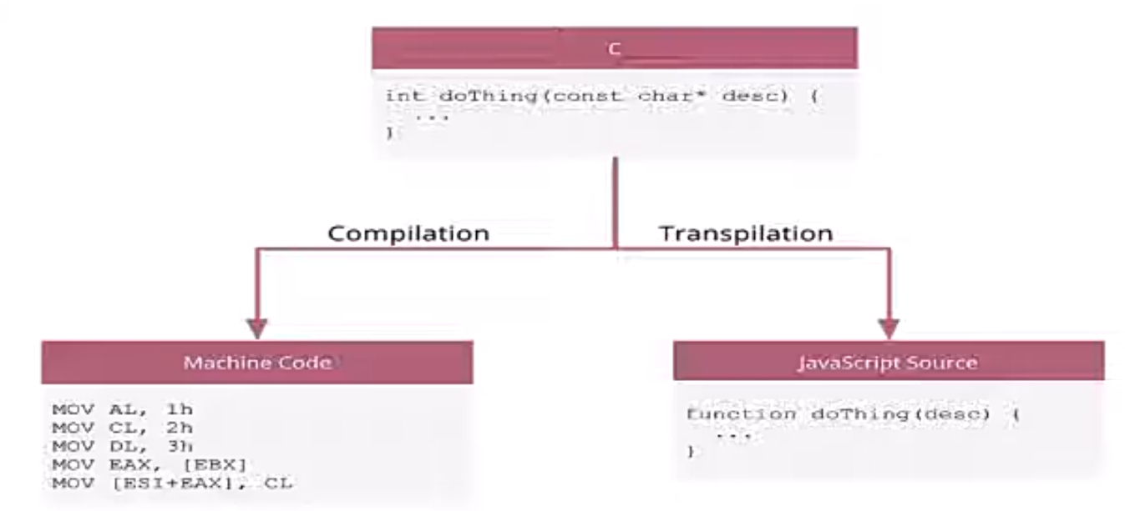
Source to source compiler
The compiler that takes high level language code as input and outputs source code of another high-level language only.

Slide 8
Examples of Compilers
1.Ada compilers
2 .ALGOL compilers
3 .BASIC compilers
4 .C# compilers
5 .C compilers
6 .C++ compilers
7 .COBOL compilers
8 .Common Lisp compilers
9. ECMAScript interpreters
10. Fortran compilers
11 .Java compilers
12. Pascal compilers
13. PL/I compilers
14. Python compilers
15. Smalltalk compilers

